Slide 1
Data Science Project
Predicting dielectric constant and dielectric loss of Composite
HDPE+ (added material)-> Composite

Slide 2
Abstract: The objective of this study is to devise a straightforward approach for the rapid prediction of the dielectric permittivity and dielectric loss of HDPE composites using Machine learning. By doing so, the goal is to expedite the material development process by avoiding the need for extensive experimental testing...

Slide 3
Predicting Dielectric constant and dielectric loss of HDPE TiO2 composites
Features: HDPE%, frequency
Target variables: D, K

Slide 4
Work flow:
1) Collect data
2)Data cleaning
3)Model building
4)Model validation
5)Data Visualization

Slide 5
Method1: Train different models with 80% of H0T,H10T,H20T,H30T,H40T data Testing with 20% of the total data for accuracy HXT- HDPE X%TiO2

Slide 6
Results

Slide 7
Accuracy(r2_score) (0-least fit,1-best fit)
Algorithm D K
Random Forest 0.9922 0.9998
Gradient Boosting 0.9880 0.9998
Decision Tree 0.9737 0.9994
Adaboost 0.8898 0.9993
KNN -0.1132 -0.3027

Slide 8
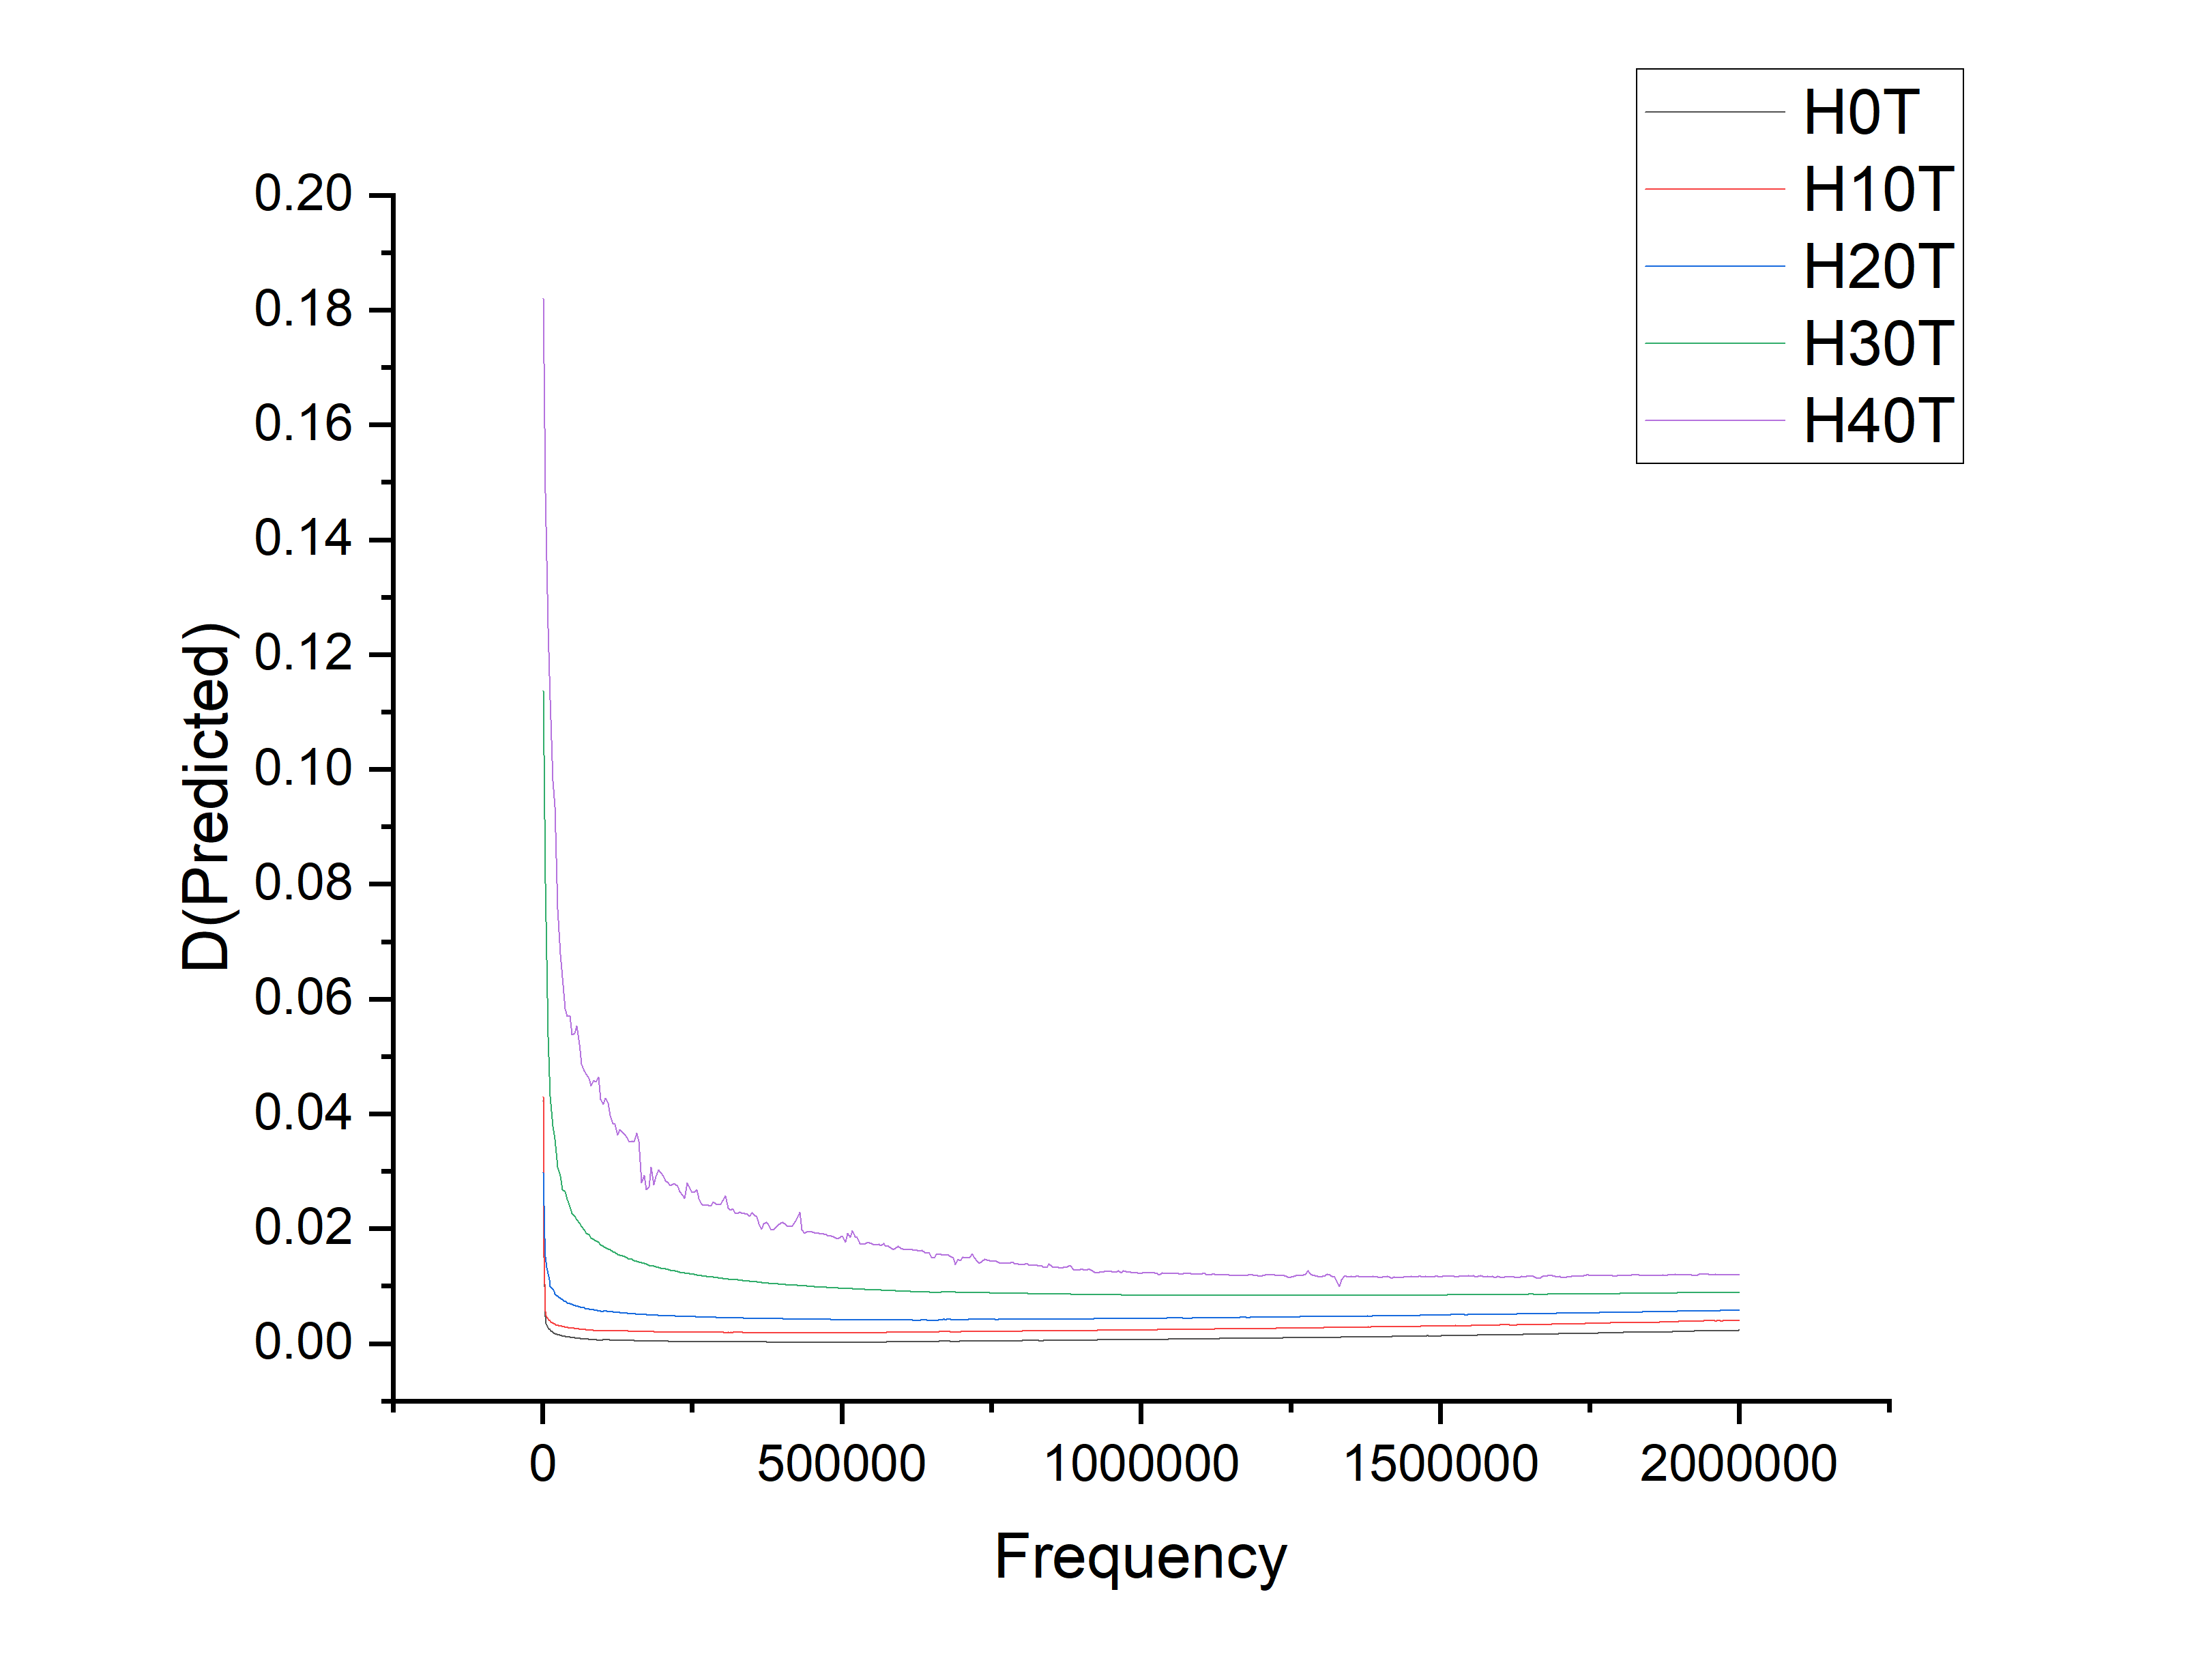
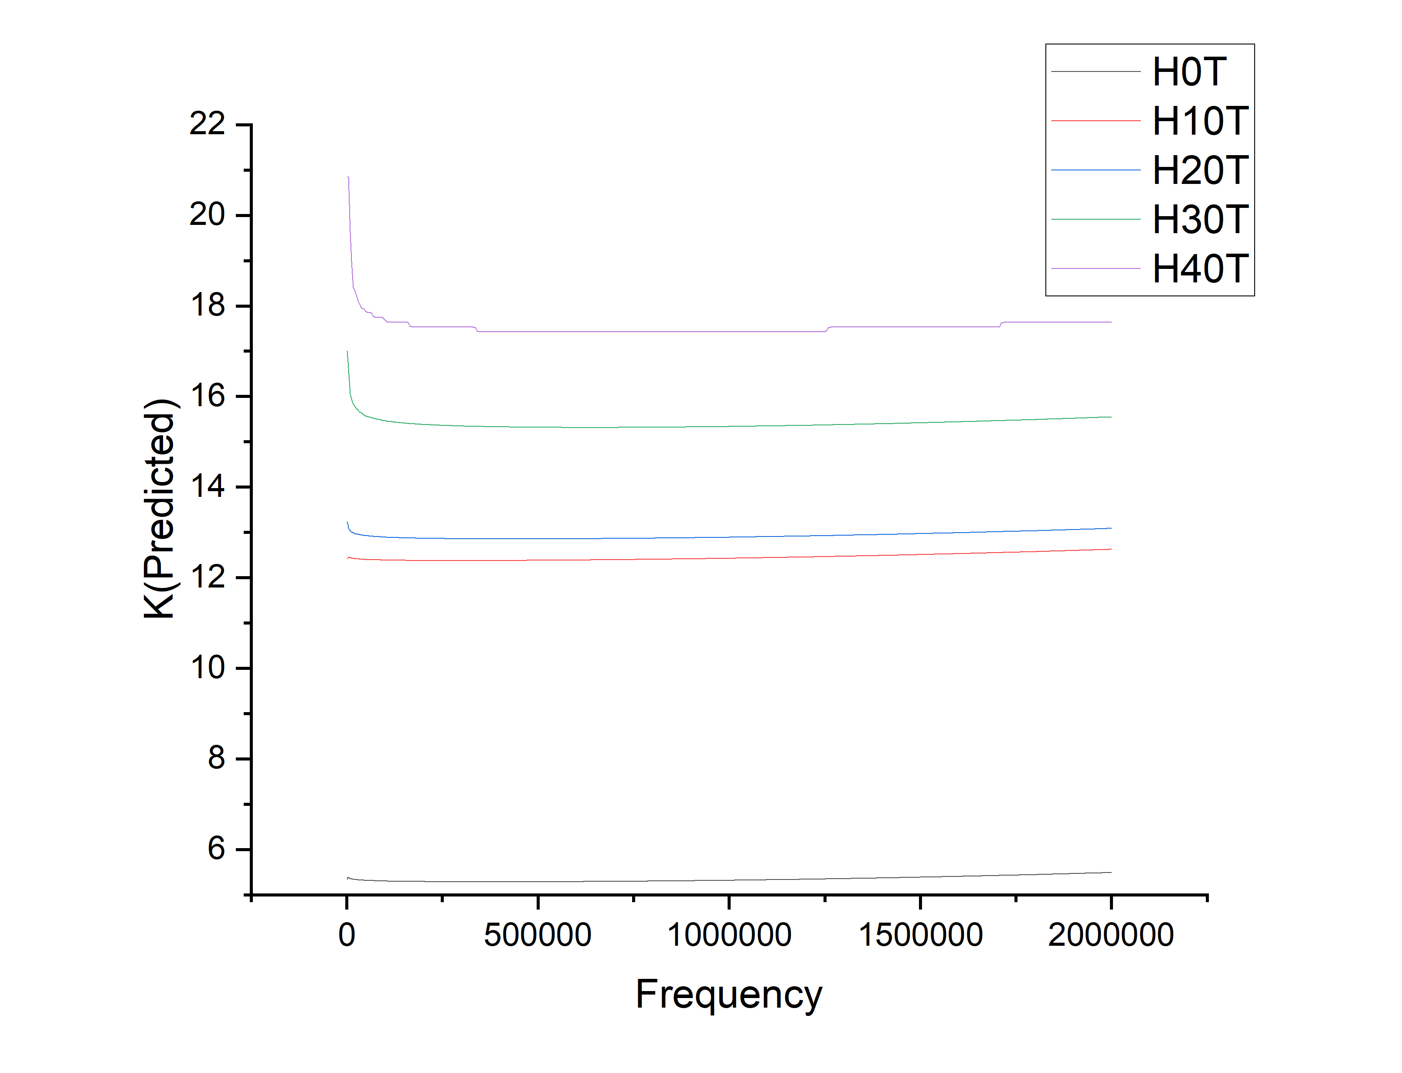
Using Random Forest(Best algorithm for this data)

Slide 9
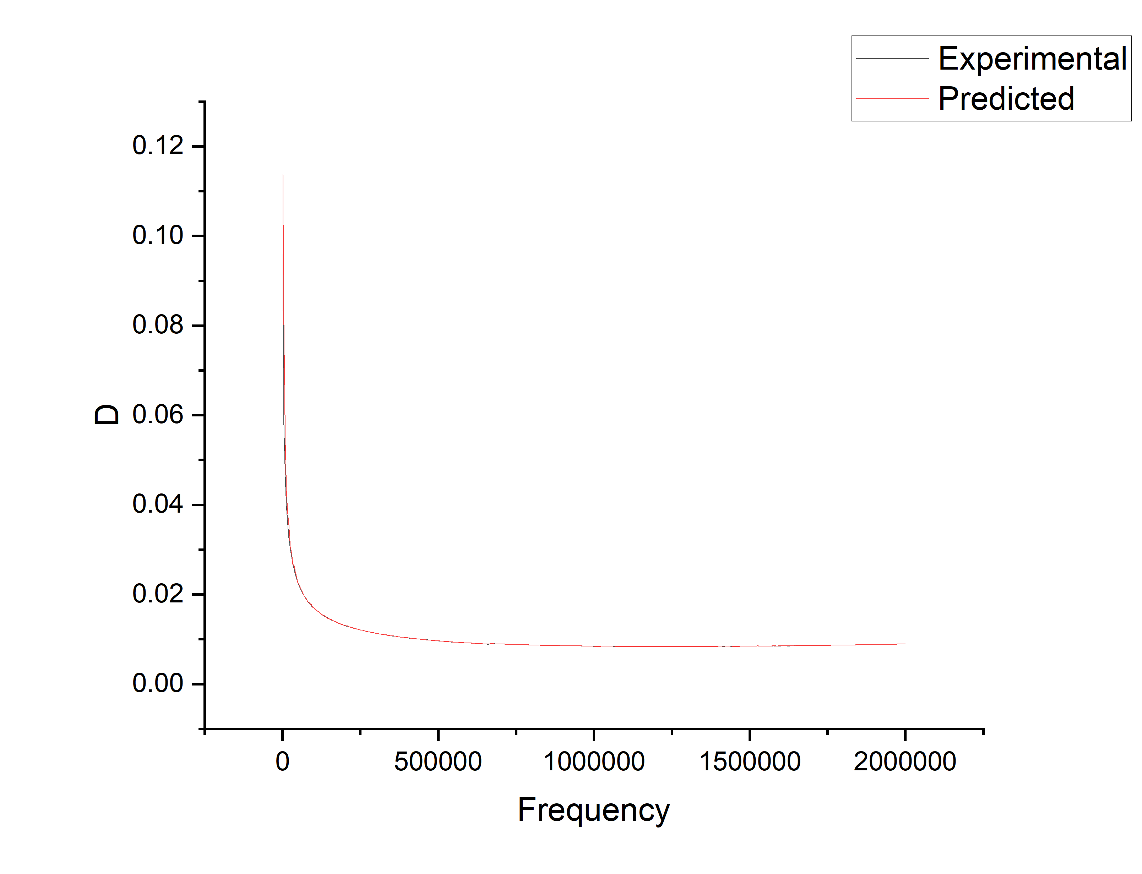
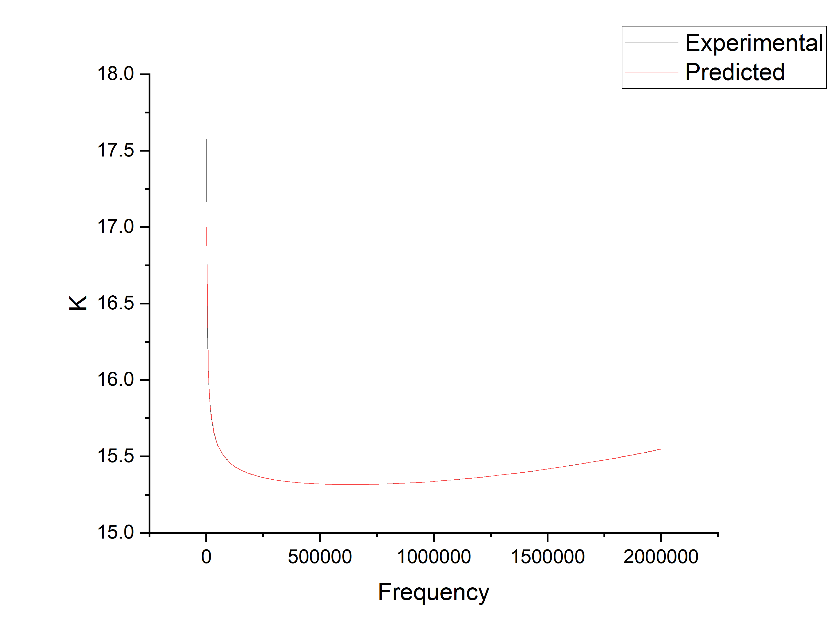
Random forest algorithm on H30T

Slide 10
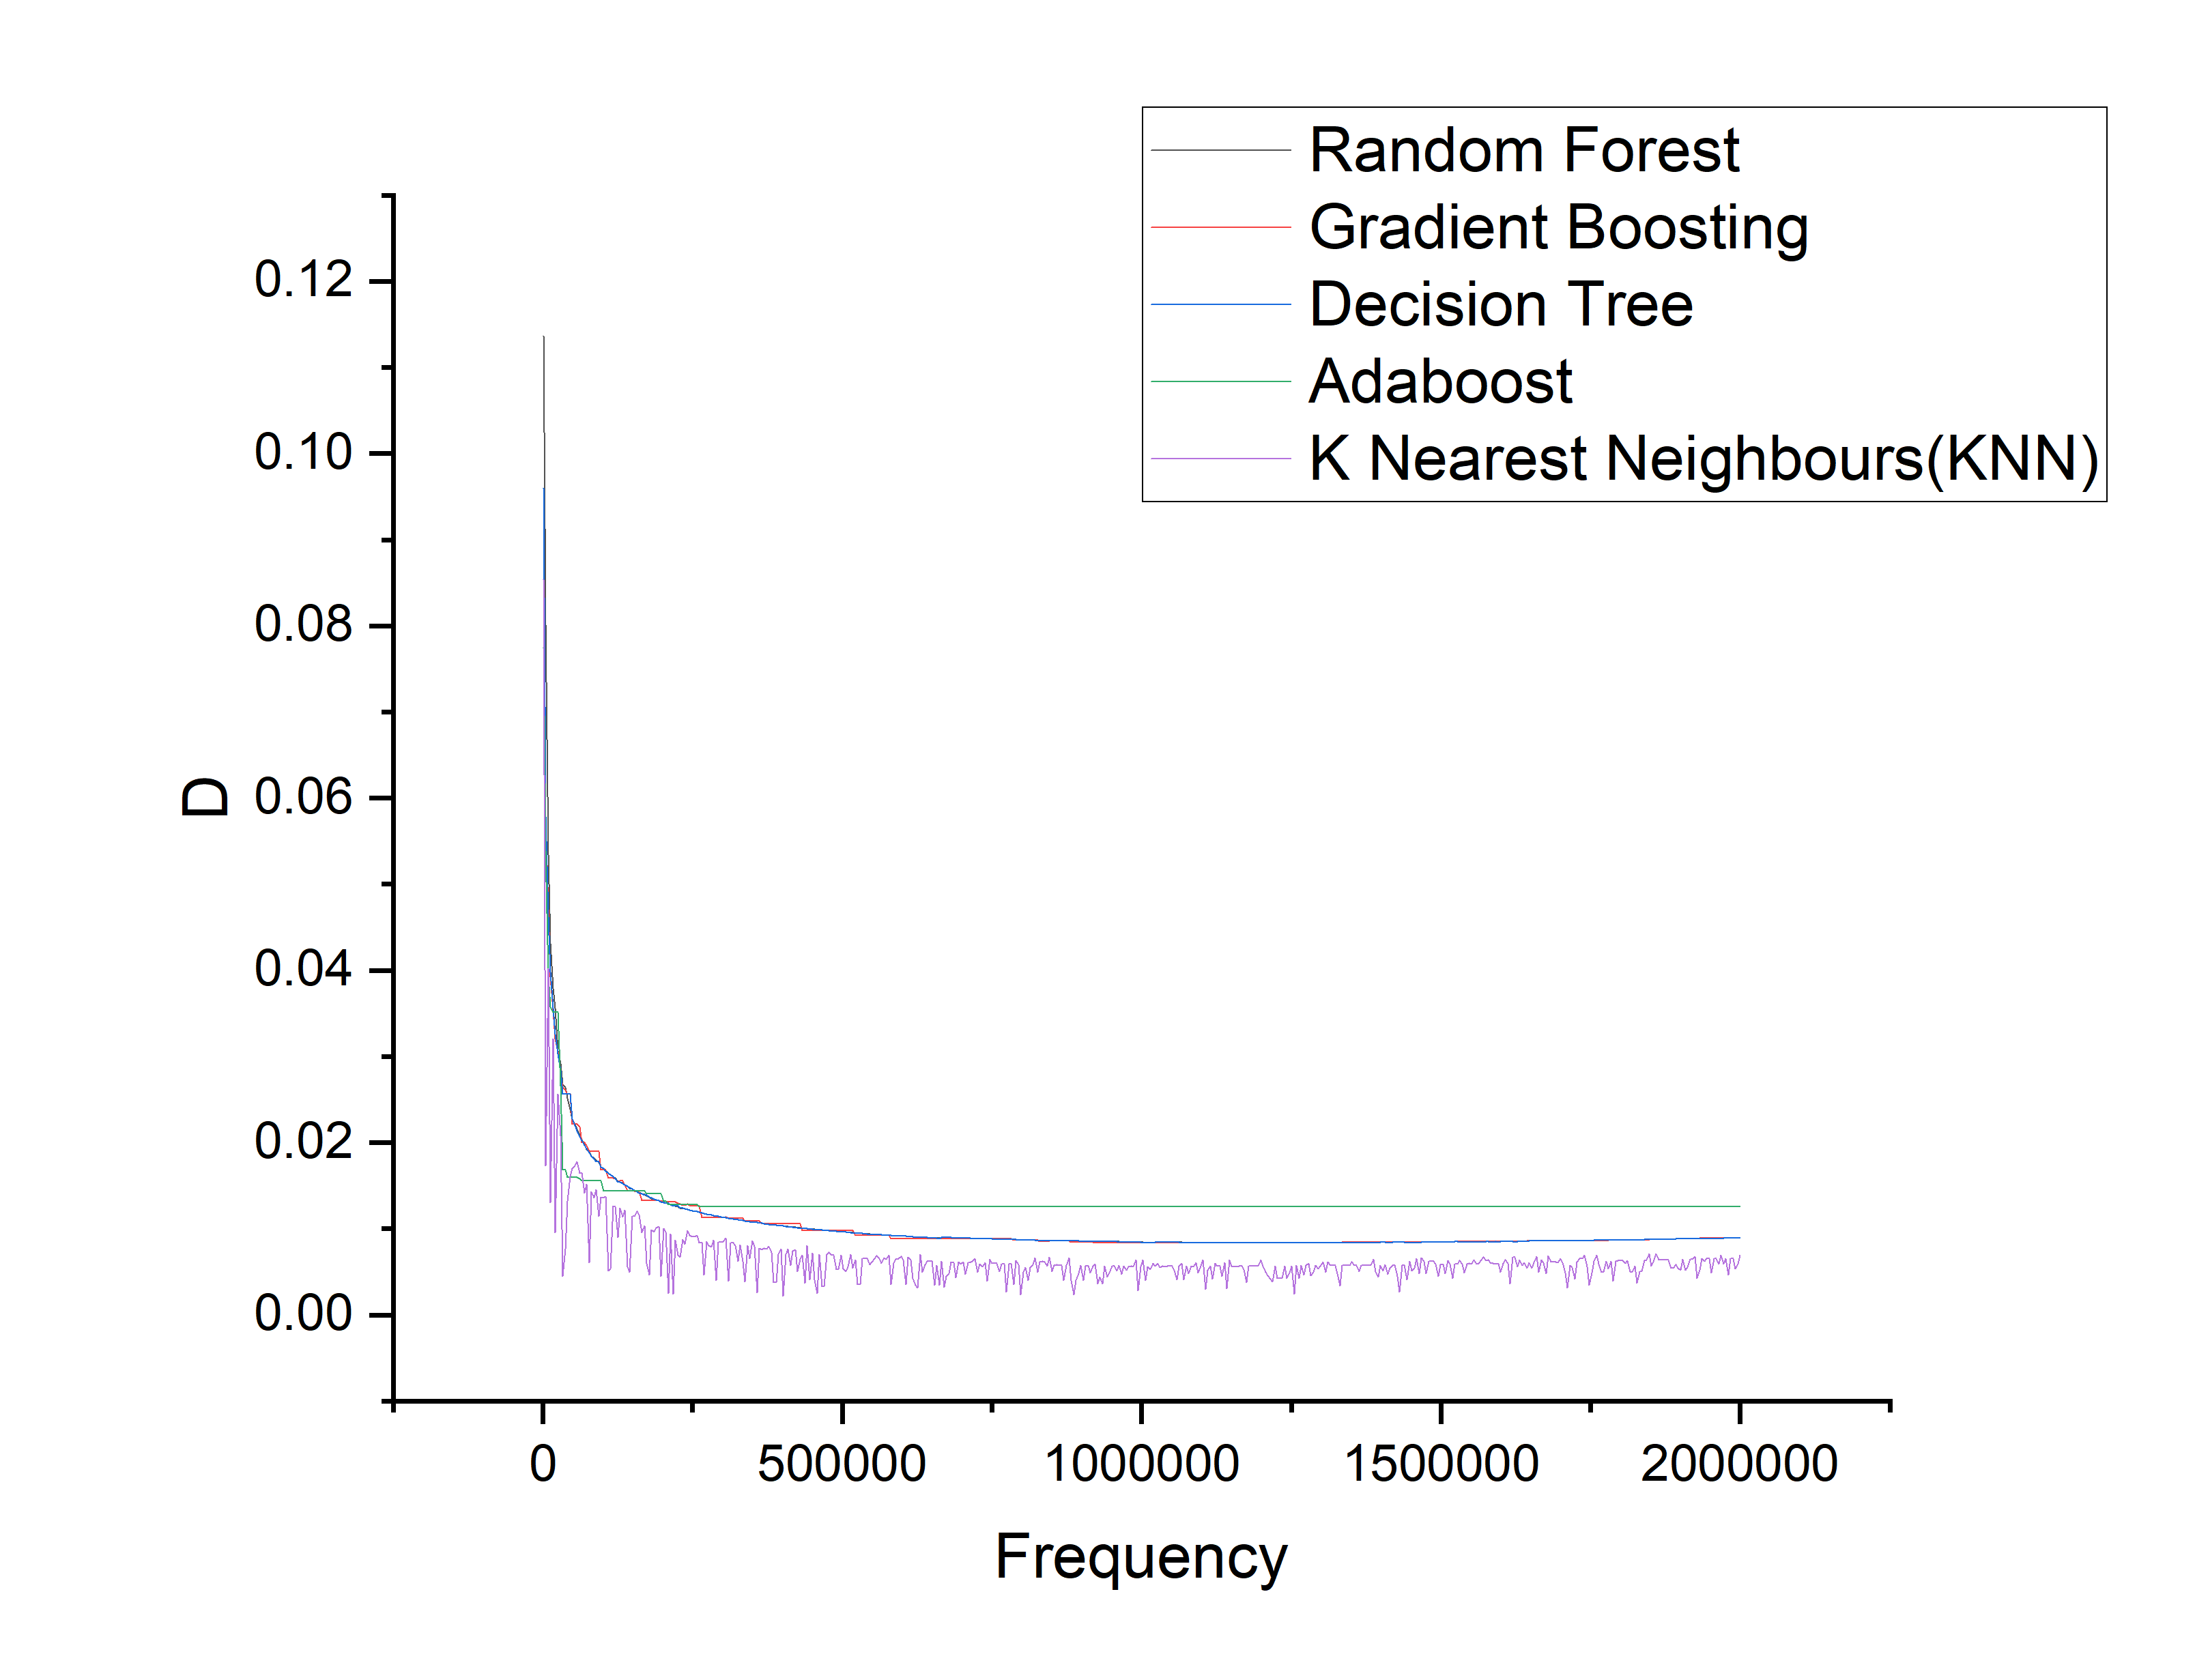
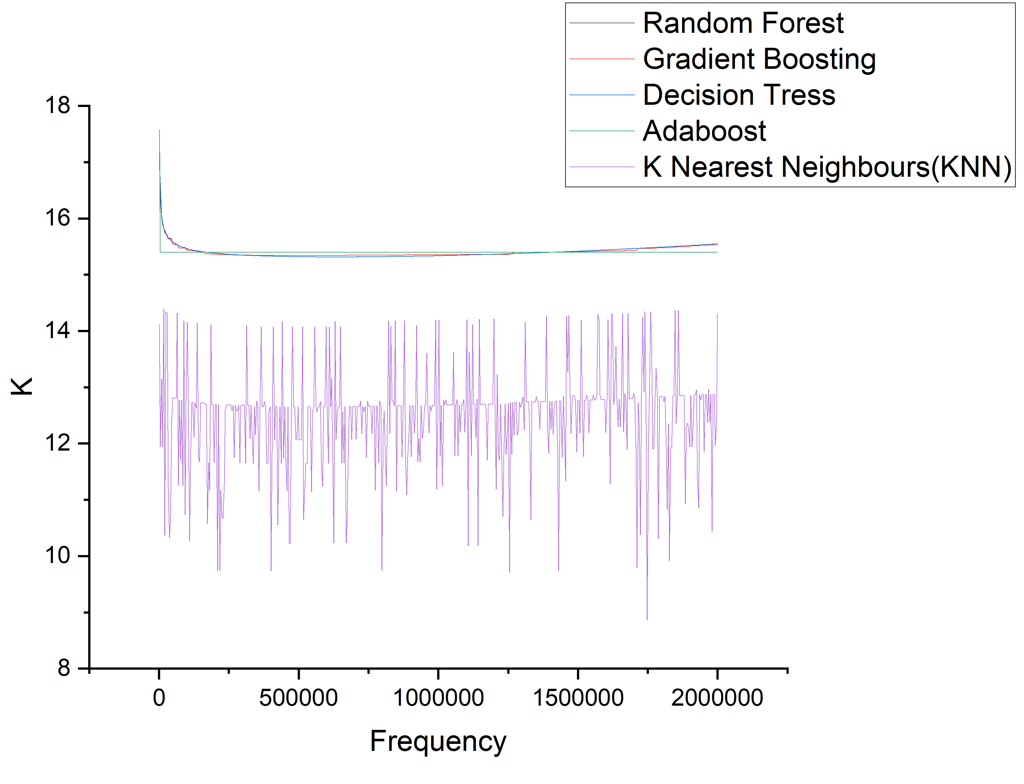
Comparison of different algorithms on H30T

Slide 11
Method2: Training with H0T,H10T,H20T,H40T
test with H30T
Different algorithms are tested and they are giving negative results. The reasons are the main disadvantages of machine learning algorithms:

Slide 12
Machine learning models, including regression models, tend to extrapolate less reliably outside the range of values they were trained on.
Machine learning models learn patterns from the training data, and their predictions are typically most accurate within the range of values they have seen during training. When you try to predict for compositions beyond 0% to 40% TiO2, the model is essentially extrapolating, and the accuracy of these extrapolated predictions can deteriorate.

Slide 13
Proposed Solution
We can divide all different composition data into two parts (60 to 80% of each of H0T,H10T,H20T,H30T,H40T data for training and test with other part to get the above graphs. The key thing to note is
Machine learning algorithms heavily rely on high-quality, relevant, and representative data. If the training data is biased, incomplete, or not reflective of the real-world scenario, it can lead to inaccurate predictions.

